Slide 1
Gas Laws
Learning Intentions:
• Use the Kinetic Theory of Matter to explain
- relationship between heat and temperature
- the characteristics of gases
• Predict the effect on gases of changes in pressure, temperature and volume
• Recognize the conditions of STP are 0.0ºC and 100.0 kPa
• Perform mass to volume (gases at STP) calculations useful the ideal gas constant .
(1 mole of any gas occupies 22.71 litres at STP)

Slide 2
The presence of gases in the environment often goes unnoticed because they are less obvious than solids and liquids. However, gases form a large part of the natural environment and are widely used for a range of products and appliances.
For example, atmospheric gases such as oxygen, carbon dioxide and nitrogen are essential for life on Earth and many household products contain gases such as light globes, soft drinks and aerosols.

Slide 3
There is a great deal of similarity between the properties of gases and because of these similarities chemists have established a set of laws and relationships based on the idea of an ‘ideal’ gas. Of course not all gases will follow these laws perfectly but under normal conditions the behaviour of most gases is close enough to being ideal for these laws and relationships to be used.

Slide 4
What are the properties of gases?
There are five main ones:
Gases can be compressed
Gases can expand to fill their container uniformly
Gases have low densities
Confined gases exert pressure on the wall of the container uniformly
Gases diffuse with other gases in the same container

Slide 5
Kinetic Theory
The Kinetic Theory of Gases is the model used to explain the behaviour of gases in nature.
Gases are composed of tiny particles called molecules (Remember… molecules are two or more atoms held together by chemical bonds) This means that gases are made up of mostly empty space!
The particles are relatively widely spaced (compared to the size of each gas molecule)
The molecules move in rapid, random, straight-line motion. These movements result in collisions with each other and the sides of the container.
The forces of attraction between the molecules are negligible.
Collisions between the molecules are elastic, resulting in no net energy loss during these collisions.
The average kinetic energy of the molecules increases as the temperature of the gas increases.

Slide 6
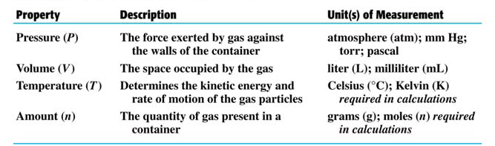
Properties that Describe A Gas
These properties are all related to one another.
When one variable changes, it causes the remaining three to react in a predictable manner.

Slide 7
Three Laws, Three people
P₁V₁ = P₂V₂
Boyle’s Law
Charles Law
Combined Gas Law
V₁ = V₂
T₁ T₂
P₁V₁ = P₂V₂
T₁ T₂

Slide 8
Gases are most easily measure by their volume. However, you also need to take into account the temperature and pressure as these can affect the quantity of a gas.
A greater amount of gas will fit into a container when the temperature is low and the pressure is high. Why is this?

Slide 9
Units
Volume Litres (L) = 1000 mL
Temperature °C or kelvin (K)
Pressure 1 atmosphere = 1.00 atm = 101.3kPa = 760.0mmHg
* Temperature should always be converted to kelvin. Just add 273 to the given temperature in ° C . EASY! ☺

Slide 10
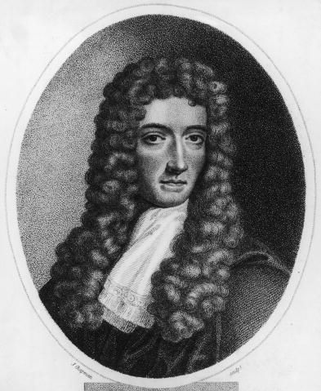
Boyle’s Law
Boyle's law (sometimes referred to as the Boyle-Mariotte law) is one of the gas laws and basis of derivation for the ideal gas law, which describes the relationship between the product pressure and volume within a closed system as constant when temperature and moles remain at a fixed measure; both entities remain inversely proportional.

Slide 11
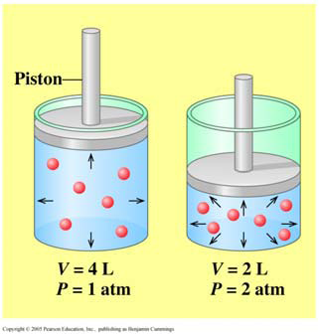
Boyle’s Law – V and P
Boyle’s law states that the volume of a gas is inversely proportional to the pressure at a constant temperature.
Mathematically we write:
P α 1
V
For a before and after situation:
P₁V₁ = P₂V₂

Slide 12
Boyle Problem…
A 1.50 L sample of methane gas exerts a pressure of 1650 mm Hg. What is the final pressure if the volume changes to 7.00 L?
Step 1: Organize the data in a table with initial (1) and final (2) conditions.
Step 2: Rearrange the gas law to solve for the unknown (here, P₂)
Step 3: Plug your numbers into Boyle’s Law and solve for P₂

Slide 13
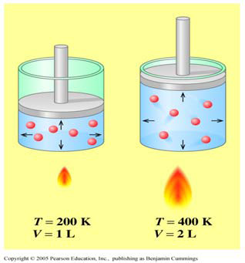
Charles Law – V and T
In 1783, Jacques Charles discovered (while hot air ballooning) that the volume of a gas is directly proportional to the temperature in Kelvin.
Mathematically, we write:
T α V
For a before and after situation:
V₁ = V₂
T₁ T₂

Slide 14

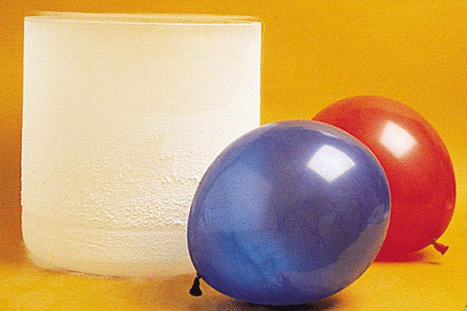
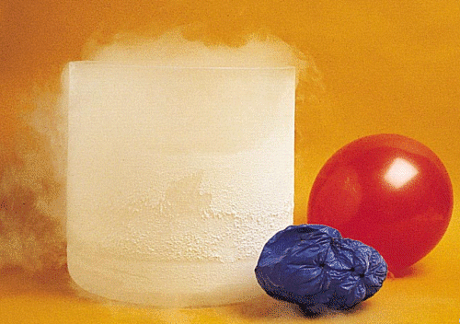
When we use liquid nitrogen just look at the change in the partial pressure applied on the balloon due to the drop in temperature

Slide 15
Charles Law Problem…
A 275 L helium balloon is heated from 20°C to 40°C. What is the final volume at constant P?
Step 1: Temperatures must be in Kelvin. Convert from °C to K if needed:
20°C + 273 = 293 K and 40°C + 273 = 313 K
Step 2: Organize the data in a table with initial (1) and final (2) conditions.
Step 3: Rearrange the gas law to solve for the unknown (here, V₂)
Step 4: Plug your numbers into Charles’ Law and solve for V₂

Slide 16
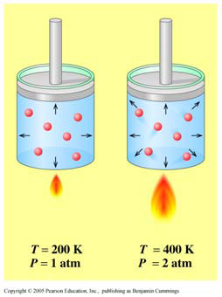
Gay-Lussac’s Law
In 1802, Joseph Gay-Lussac discovered that the pressure of a gas is directly proportional to the temperature in Kelvin.
Mathematically, we write:
T α P
For a before and after situation:
P₁ = P₂
T₁ T₂

Slide 17
Gay-Lussac Problem…
A steel container of nitrous oxide at 15.0 atm is cooled from 25°C to –40°C. What is the final volume at constant V?
Step 1: Temperatures must be in Kelvin. Convert from °C to K if needed:
25°C + 273 = 298 K and -40°C + 273 = 233 K
Step 2: Organize the data in a table with initial (1) and final (2) conditions.
Step 3: Rearrange the gas law to solve for the unknown (here, P₂)
Step 4: Plug your numbers into Gay-Lussac’s Law and solve for P₂

Slide 18
Combined Gas Law
When we introduced Boyle’s, Charles’, and Gay-Lussac’s Laws, we assumed that one of the variables remained constant.
Experimentally, all three (temperature, pressure, and volume) usually change.
By combining all three laws, we obtain the combined gas law:
P₁V₁ = P₂V₂
T₁ T₂

Slide 19
Combined Gas Law Problem…
A sample gas collected at 25 ° C and a pressure of 105kPa has a volume of 450.0mL . Calculate its volume at 0 ° C and a pressure of 100.0kPa.
Step 1: Write down the formula
Step 2: Temperatures must be in Kelvin. Convert from °C to K if needed
Step 3: Write down the data with initial (1) and final (2) conditions.
Step 4: Sub in the values
Step 5: Rearrange the gas law to solve for the unknown (here, V2)
Step 6: Calculate to solve for P₂

Slide 20
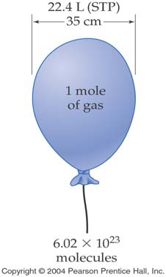
Molar Volume and STP
In order to be able to compare changes that occur in systems containing gases, a standard set of conditions are needed. A common standard of conditions known as S.T.P.
Standard temperature and pressure (STP) are defined as 0°C = 273 K and 100.0kPa.
If a chemist wishes to compare a number of volumes of gas measured under different conditions, they must first be adjusted to STP so that the effects of differing temperatures and pressures is taken into account.
At standard temperature and pressure, one mole of any gas occupies 22.71 L.
The volume occupied by one mole of gas (22.71 L) is called the molar volume.

Slide 21

STP Calcs Guide…
Mass of known
Moles of known
Moles of unknown
Mass of unknown
(use equation)
Volume of known at STP
Volume of unknown at STP

Slide 22
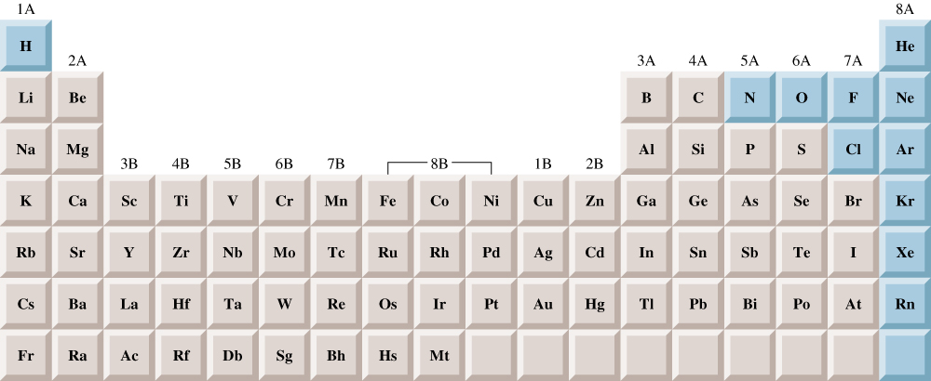
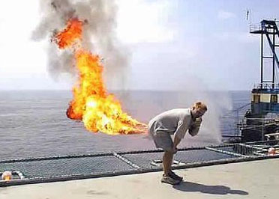
Elements that exist as gases at 25⁰C and 1 atmosphere

Slide 23
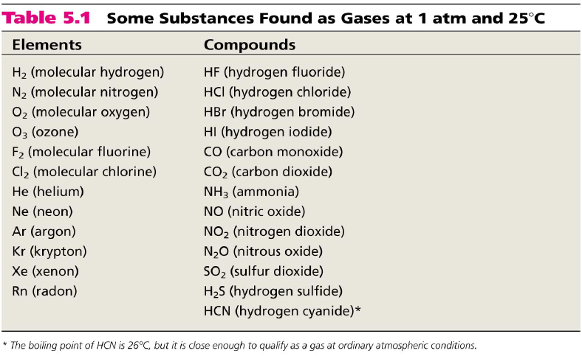

Slide 24
Questions
Read Chapter 10.6, 11.4, 11.5 Lucarelli
Complete :
Set 16
Must – Q5,6,7,10
Should – Q8,9,11
Set 18
Must – Q1,2,3
Should – Q4,5
Could – Q6,7

